Slide 1
Lecture 8 The Industrial Revolution

Slide 2
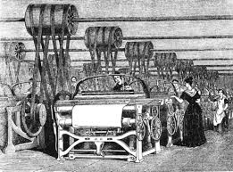
Industrial Revolution
The greatly increased output of machine-made goods that began in England .
Prior to the Industrial Revolution, people made things by hand.

Slide 4
Why did the Industrial Revolution Begin in England?
Factors of Production: The resources needed to produce goods and services that the Industrial Revolution required.
Land
Labor
Capital (wealth)

Slide 5
HOW IT SPREAD?

Slide 6
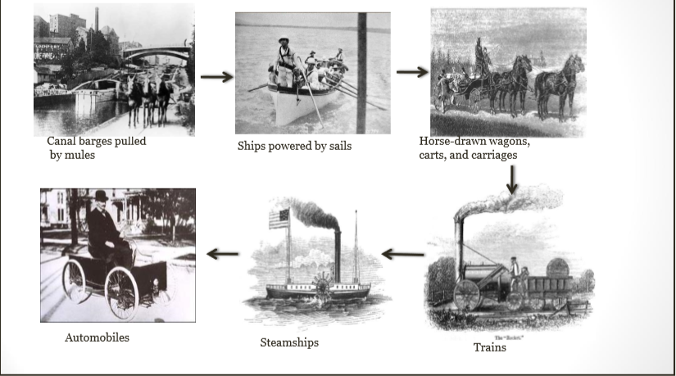
Advancements in Transportation

Slide 7
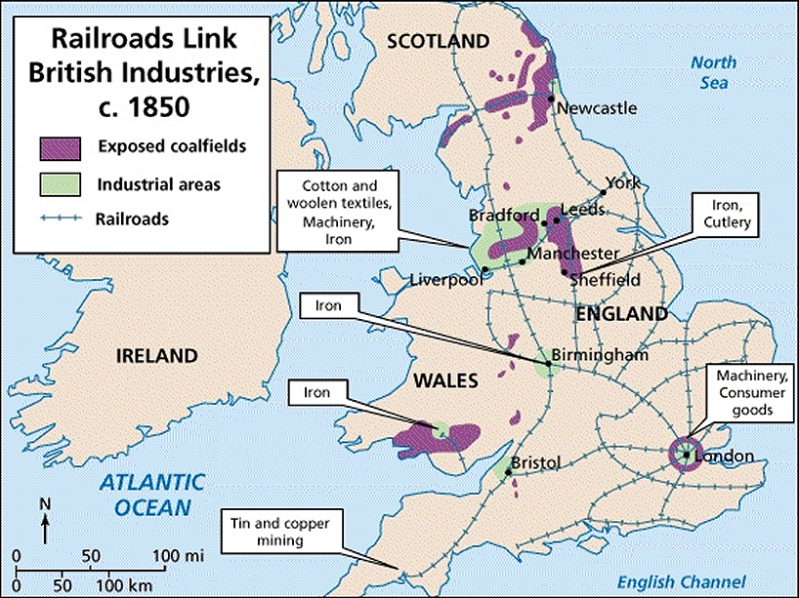

Slide 8
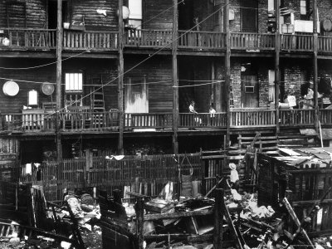
Architectural Character of the cities
Cities developed around factories.
Houses built in courts with principle that 3 walls are shared with other houses reducing the amount of material used.
It was very compact and streets are very narrow and would not allow for light or sufficient air to enter the house.

Slide 9
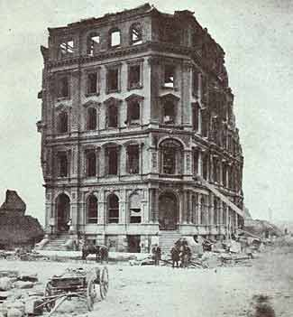
Each house could have from 1 to 3 families living inside and even possible animals.
A lobby/ living space , the kitchen and toilet were communal and often shared between 16 households.
The courtyards had privies (outdoor toilets), cooking, storage areas and cesspool (hole to receive waste from house).

Slide 11
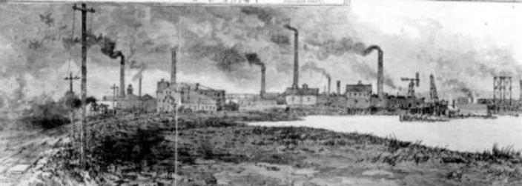
Industrialization Changes Life
People could earn higher wages in factories than on farms.
More money helped people heat homes, eat well and wear nicer clothing.
Cities swelled with waves of job seekers.

Slide 12
EFFECTS OF INDUSTRIAL REVOLUTION
Manufacturing of goods was concentrated in a central location.
Population in cities more than doubled, some even quadrupled.
Period was known as Urbanization – City building and the movement of people to cities.
Factory workers lived in dark, dirty shelters.
Sickness spread.
Cholera swept through slums.

Slide 13
TECHNOLOGICAL ACHIEVEMENT AND ITS REFLECTION IN PLANNING

